Slide 1

Bangladesh Army University of Science and Technology (BAUST) Saidpur Cantonment, Nilphamari
Department of Computer Science and Engineering (CSE)
Course Code : CSE 4000
Course Title : Thesis
Thesis Title : MediNet-XG: A Lightweight Explainable Multimodal AI for Medicinal Plant from weed infested area.
Date : 18 January 2026
Presented By:
Name : Md Nur A Alam ID : 210201044 Batch : 13th
Supervised By:
Professor Dr. S.M. Jahangir Alam
Co-Supervised By:
Saad Ahmed (Lecturer)

Slide 2
Outline
Introduction
Problem Statement
Objectives
Related Works
Proposed Methodology
Dataset
Preliminary Results / Progress
Project / Thesis Timeline
Expected Outcomes
Challenges
Conclusion
References

Slide 3
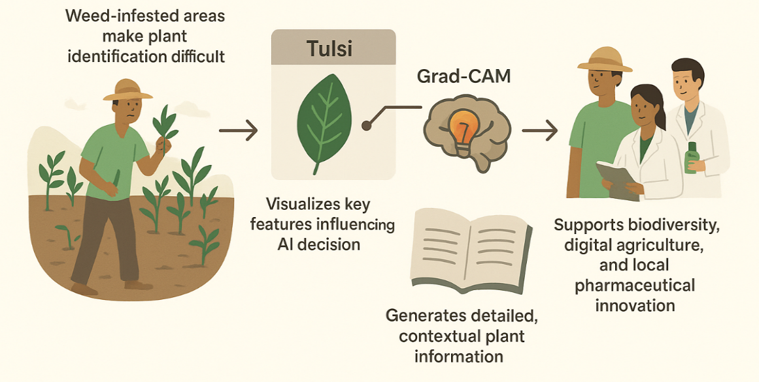
Introduction
Medicinal plants = vital source of traditional healthcare & biodiversity in Bangladesh.
Weed-infested environments plants are unknown, recognition complex and error-prone.
Existing deep models classify species but lack interpretability and contextual insights.
There are some study-
WHO estimates 60–79% of people depend on plant‑based medicine for health needs^{[1]}
70% Kenyans have used medicinal plants for medical purposes^{[2]}
Globally, about 50–95% of people use herbal medicines^{[3]}
One-stop solution: MediNet-XG — An Explainable Lightweight AI Framework.
Targeted for Bangladeshi researchers, herbal practitioners, and farmers.
Figure 1: Overview of the MediNet-XG

Slide 4
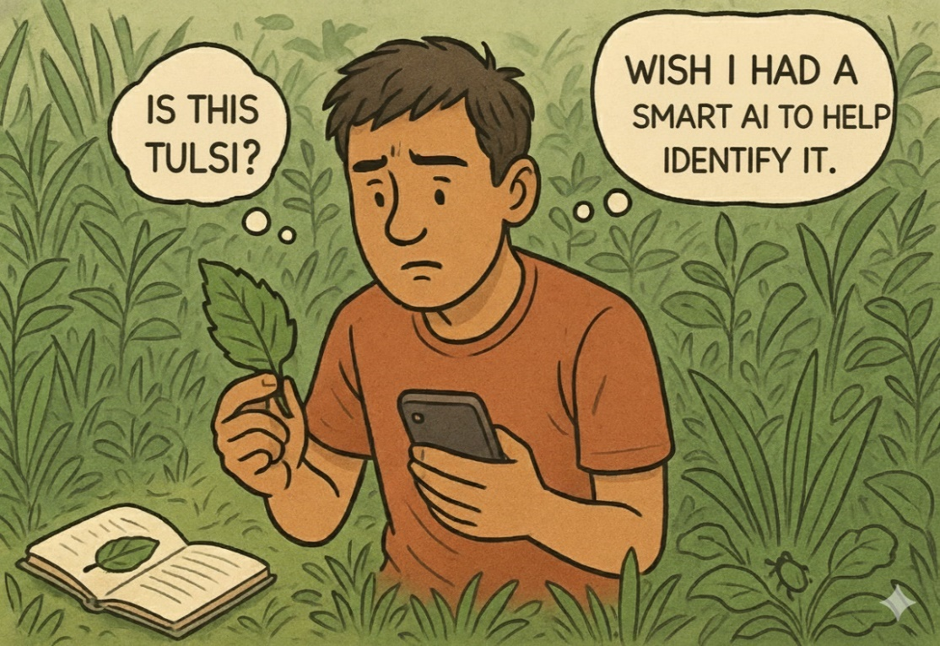
Problem Statement
Rich Medicinal Flor: Bangladesh has ~722 medicinal plant species (700 used medicinally), but visual similarities make identification difficult.^{[4]}
Traditional Methods: Manual identification by taxonomists is slow, complex, and error-prone^{[5]}
Lack of Smart Systems: No low-cost, mobile/IoT-ready system exists to classify, explain, and provide knowledge on medicinal plants.
Explainability Gap: Existing AI models lack transparency, making their decisions hard to trust. ^{[5]}
Figure 2: Traditional Method inspection hassle

Slide 5
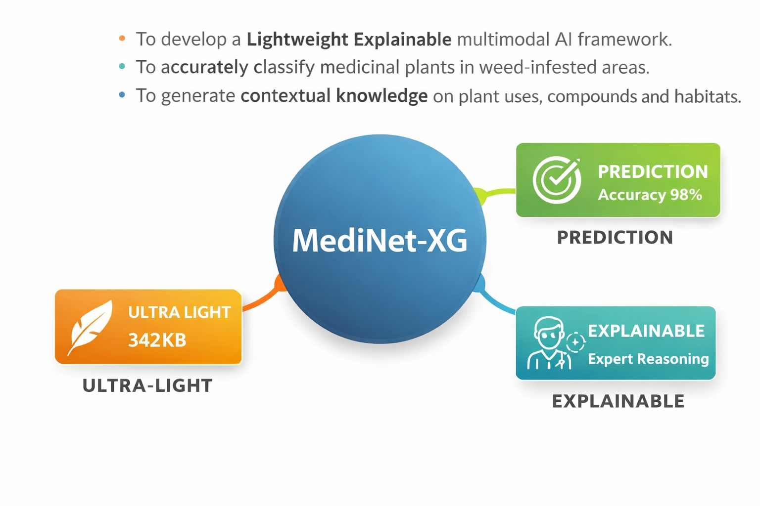
Objectives
To develop a Lightweight Explainable multimodal AI framework.
To accurately classify medicinal plants in weed-infested areas.
To generate contextual knowledge on plant uses, compounds, and habitats.
Figure 3: Objectives of the MediNet-XG

Slide 6
Related Works (Research)
Table 1: Comparative Table- Existing Research vs. MediNet-XG
Title | Plant | Modality | Real-time | Classify | XAI | Gen | Acc | Loctio
Deep-Learning-Based Class. (Mathematics, 2023)[6] | BD medicinal (10 spp., controlled leaf) | Image | No | Yes | No | No | 97.62% | BD
DL for Med. Plant: Review (Frontiers, 2024)[7] | Multi-country survey | Image | No | Yes | Rarely | No | NA | Global
IndoHerb: Indonesia (Comp. Elec. Agri, 2023)[8] | Indonesian herbal | Image | No | Yes | No | No | ~97% | Indonesia
Explainable DL: Plant Phenotyping (Frontiers, 2023)[9] | Gen. crops phenotyping | Img+Data | No | Yes | (Grad-CAM) | No | NA | Global
DL for weed detection: Wheat (Comp. Elec. Agri, 2024)[10] | Weeds vs crop in wheat | Image | Field | Yes | Limited | No | >95% | Turkey
Dual-attention model (Journal TBD, 2025)[11] | BD medicinal plants | Image | No (Heavy) | Yes | No | No | ~97% | BD
Novel Multistage Approach (IR-JMITE, 2025)[12] | Med. vs Fruit vs Flower | Image | No | Yes | No | No | >95% | Global
DL for weed detection: Review (Frontiers, 2026)[13] | Complex field weeds | Image | Edge focus | Yes | Sparse | No | NA | Global
MediNet-XG (Proposed) | BD weedy medicinal (34 spp.) | Multimodal | Yes | Yes | Yes | *yes | 98.82% (~342KB) | BD
*Note: Retrieval-based structured knowledge; non free-form generative.

Slide 7
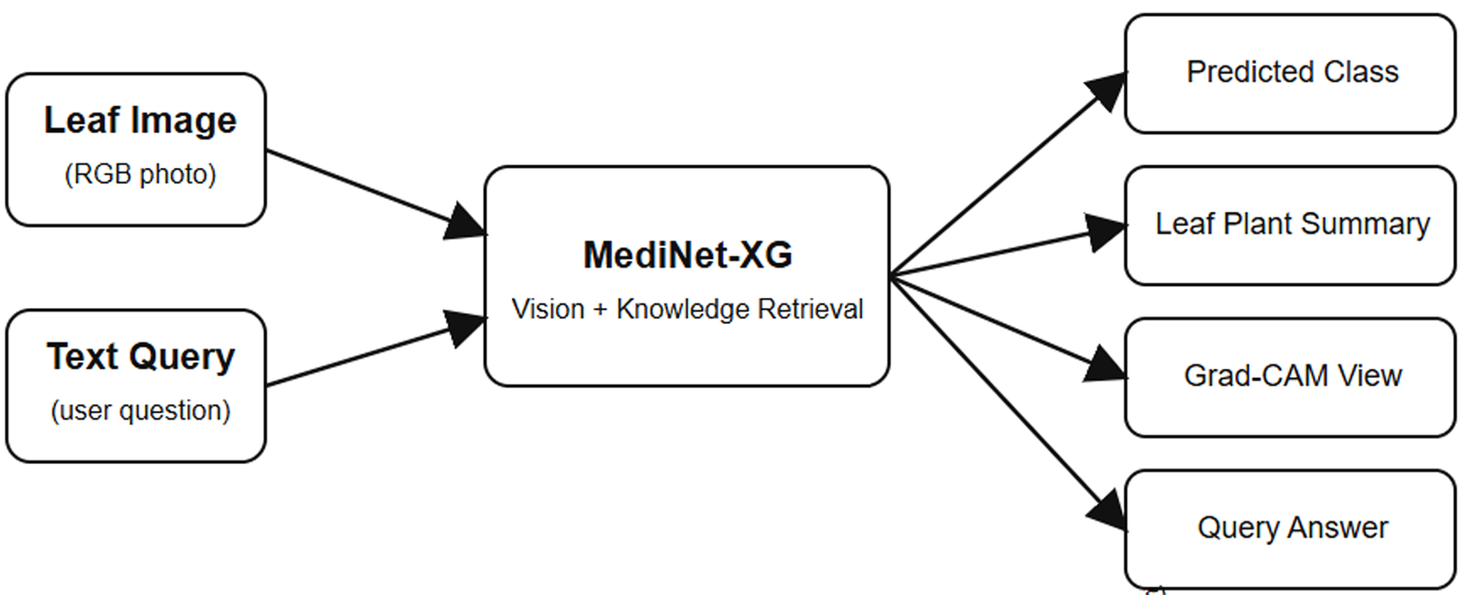
Related Works (system)
MediNet-XG is positioned as the superior solution because of:
Local Classification Accuracy & Lightweight Design for field use.
Trustworthy Decision Making by incorporating multimodal XAI (using Grad-CAM + Lime + t-SNE)
Contextual Intelligence like RAG methodology of generative knowledge based out.
This framework offers the "What" (Classification), the "Why" (Explainability), and the "What Now" (Generative Knowledge) in a single, efficient package ready for the field.
Figure 4: MediNet-XG superior position

Slide 8
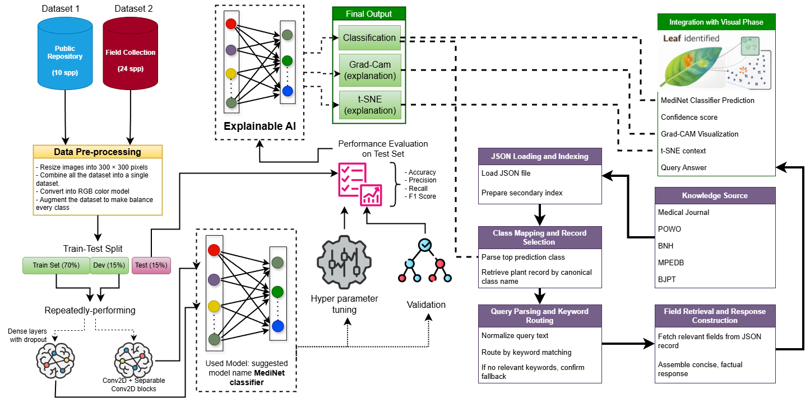
Proposed Methodology
Figure 5: Methodology & Architecture

Slide 9
Proposed Methodology
A Multimodal AI framework that fuses leaf image data to:
Classify into 34 distinct classes
Explained on it’s decision
Generate it’s all specific info that could be needed.
Methodology Stage:
Dataset Development (Image+text)
Data Preprocessing
Feature Engineering
Model Architecture
Training & Evaluation
Comparative Analysis
Integrate Grade-CAM and t-SNE for explanation
Knowledge based query answer generator

Slide 10
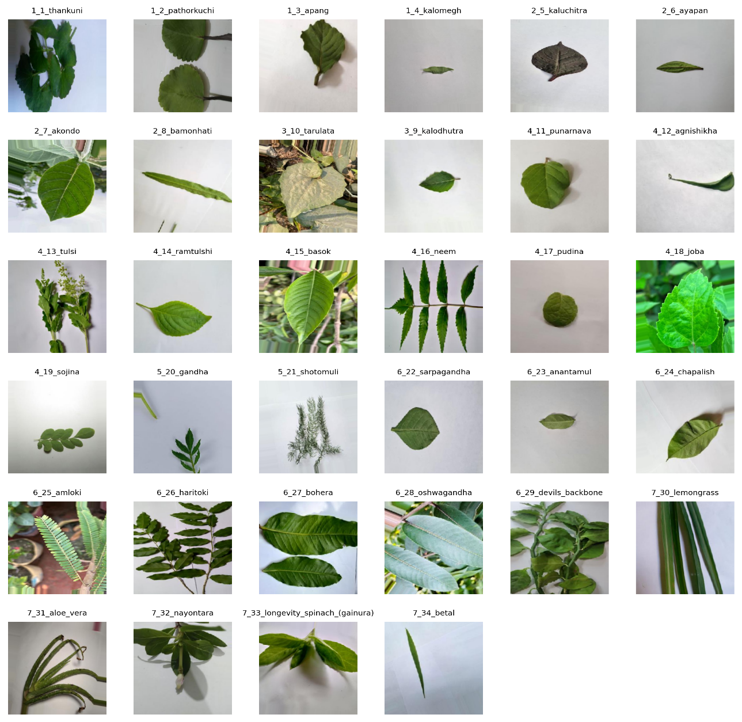
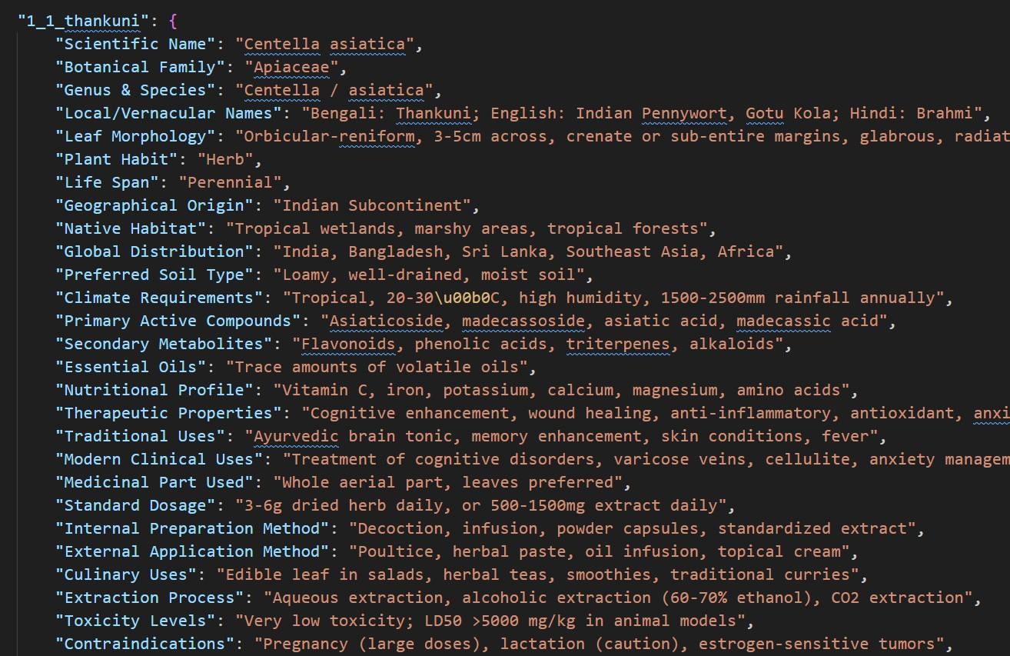
Dataset
Data Composition:
Total classes: 34 medicinal plant species
Modality:
Image (RGB)
1020 query and crossponding answer about the plant (Text)
Data Collection Plan:
Image Source: Field Collection (24 species) + Public Repositories named Mendeley (10 species) ^{[14]}
Text source: MPEDB^{[16]}, BNH^{[17]}, BJPT^{[18]}, POWO^{[19]}
Equipment Used: Smartphone(camera)
Validation: Agriculture experts and Botany Faculty member
Quantity: 17,050 total (500 per class) images and 1020 queries.
Dataset Link: kaggle^{[15]}
Figure 6: Dataset Creation

Slide 11
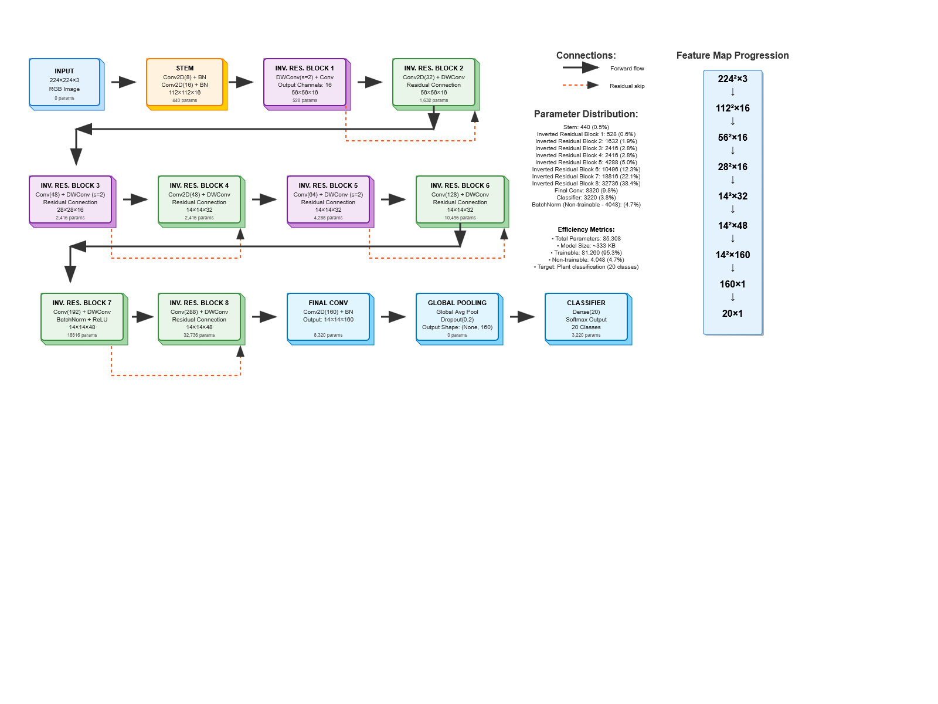
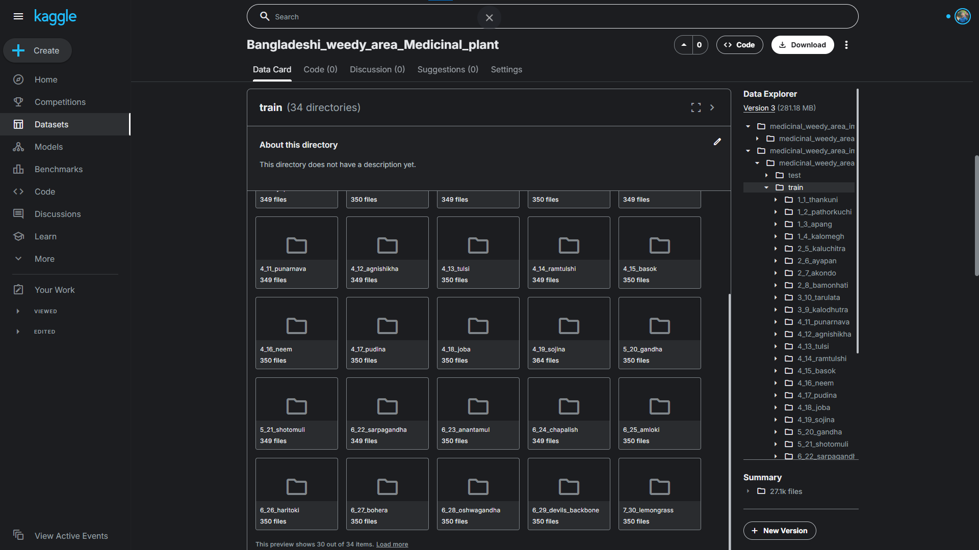
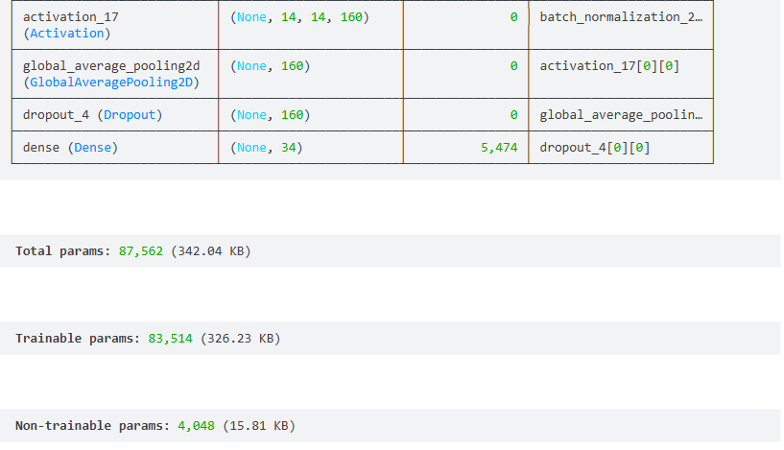
Preliminary Results / Progress
Data Collection
Total 17,050 leaf images of 34 medicinal plant species from field and public repositories
Data Preprocessing
Resized to 300×300 px,
Augmentation: rotation, flip, brightness shift
Split: 70 % train | 15 % validation | 15 % test
Figure 7: Final Dataset

Slide 12
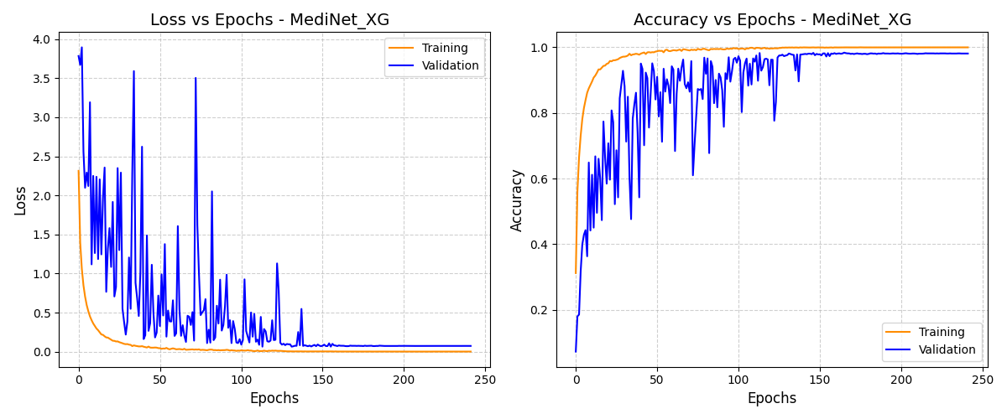
Preliminary Results / Progress
Pre-trained Model Experiments
Evaluated DenseNet121, EfficientNetB0, MobileNetV2, SqueezeNet and VGG16
Achieved strong classification accuracy across all models
Custom Lightweight Model — MediNet
Designed an extremely compact CNN (size ≈ 342.04 KB)
Incorporates depthwise separable convolutions, batch norm, dropout
Achieved 98 % accuracy, precision, recall, and F1-score
Optimized for mobile and IoT deployment
Figure 8: Custom Model Architecture and Size

Slide 13
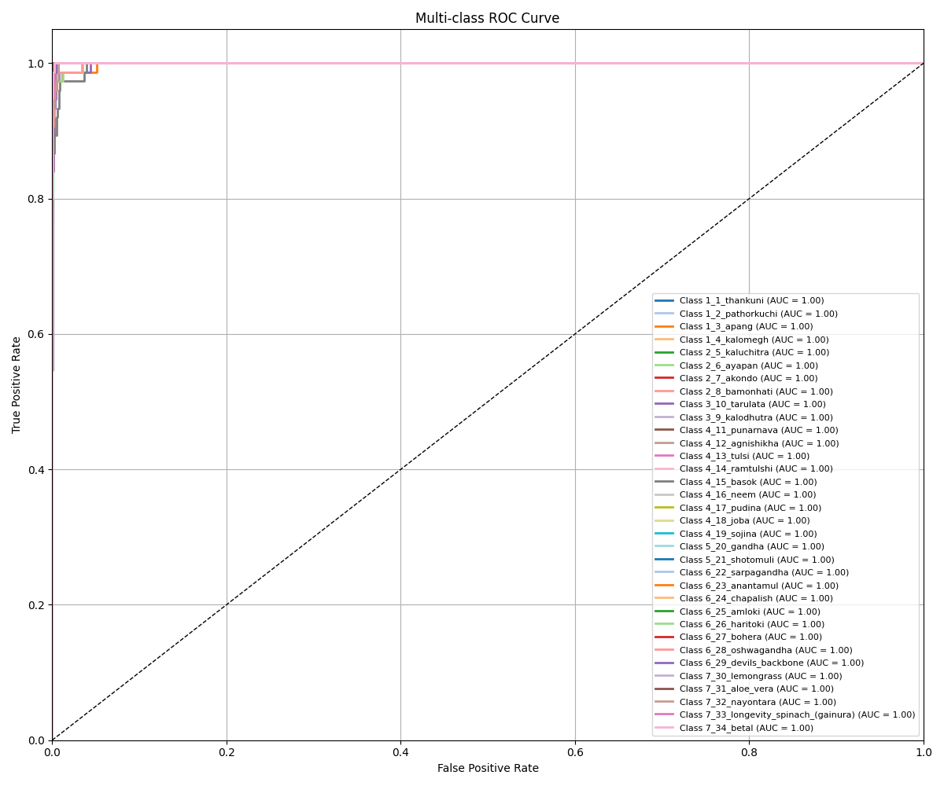
Preliminary Results / Progress
Figure 9: MediNet-XG Loss and Accuracy curve

Slide 14
Preliminary Results / Progress
Figure 10: ROC curve

Slide 15
Preliminary Results / Progress
Table 2: Comparative MediNet-XG with others pretrained model
Model | Accuracy (%) | Loss | Precision (%) | Recall (%) | F1 Score (%) | Model Size
VGG16 | 88.74 | 74.89 | 89.18 | 88.73 | 88.53 | 56.20 MB
DenseNet121 | 97.88 | 8.50 | 97.89 | 97.87 | 98.87 | 26.98 MB
EfficientNetB0_TL | 2.90 | 352.53 | 0.09 | 2.94 | 0.17 | 15.48 MB
MobileNetV2 | 98.23 | 5.35 | 98.23 | 98.22 | 68.23 | 8.64 MB
SqueezeNet | 89.21 | 31.69 | 89.54 | 89.13 | 89.03 | 889 KB
MediNet-XG | 98.82 | 4.95 | 98.75 | 98.87 | 98.79 | 342 KB

Slide 16
Preliminary Results / Progress
Table 3: Comparative MediNet-XG model on other public datasets
Dataset | Dataset Size | No. of Classes | Val Acc | Val Loss
Bean-leaf-lesions [20] | 900 | 3 | 0.8143 | 0.4380
Mango-leaf-disease [21] | 6,320 | 8 | 0.9825 | 0.0579
Tomatoleaf [31] | 7,092 | 10 | 0.9885 | 0.0362
Wheat-leaf-dataset [22] | 1,700 | 3 | 0.9190 | 0.1992
Bangladeshi weedy medicinal plants [15] | 17,050 | 34 | 0.9882 | 0.0495

Slide 17
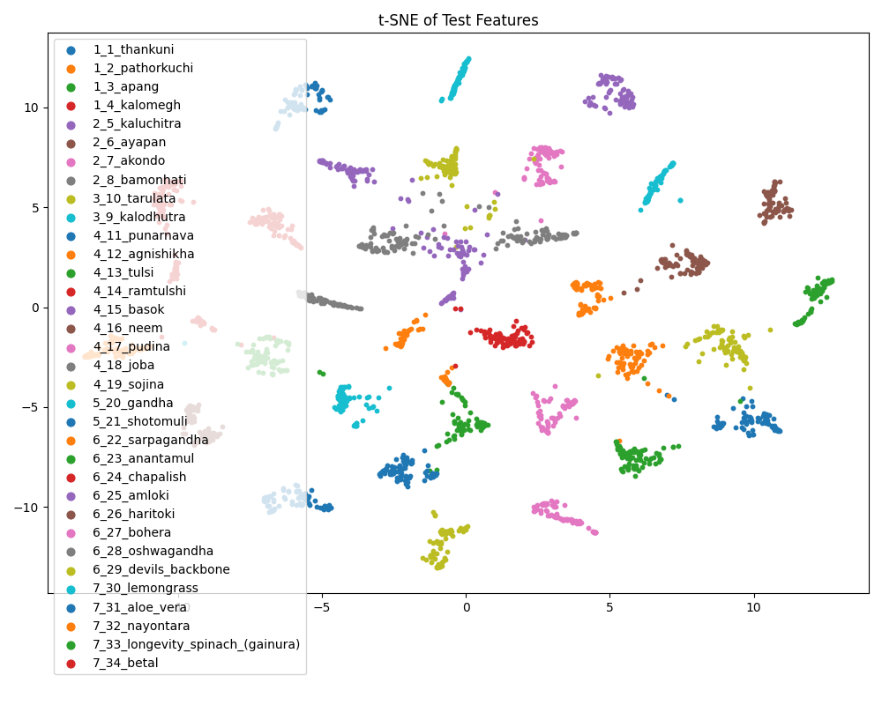
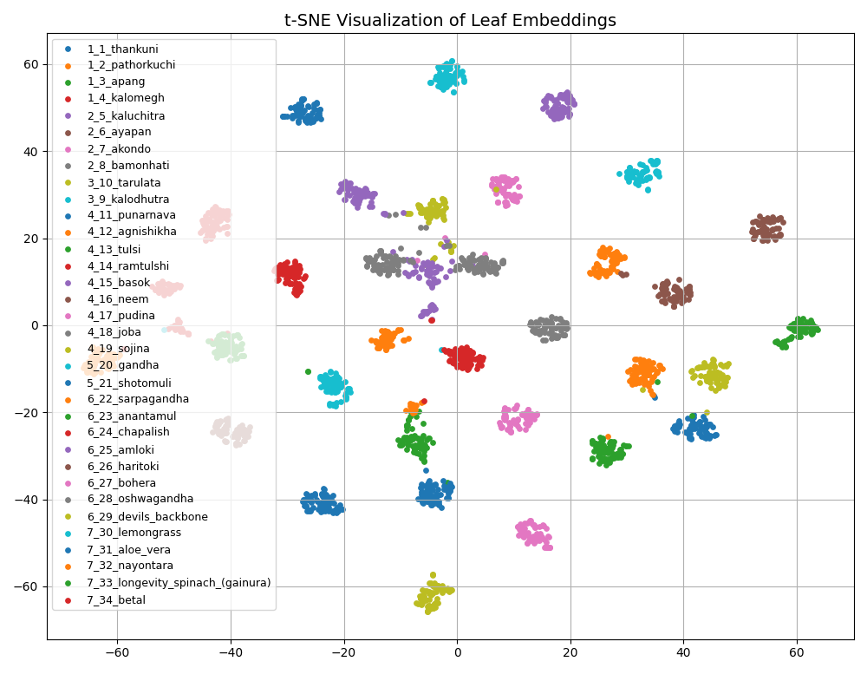
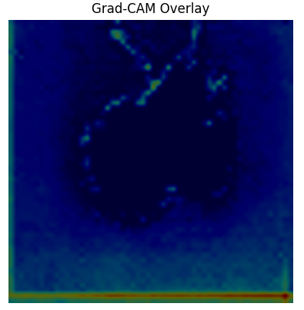
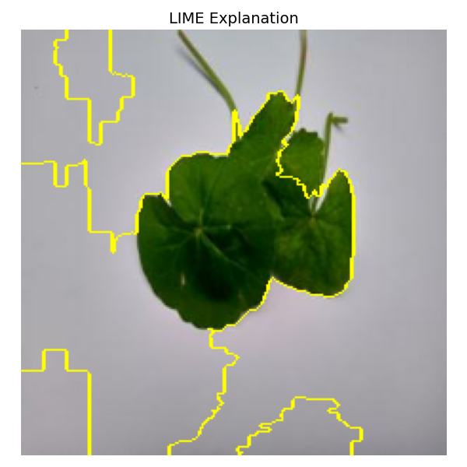
Preliminary Results / Progress
Explainability & Visualization
Grad-CAM heatmaps reveal discriminative leaf regions influencing decisions
t-SNE plots show clear inter-class separability and feature clustering
Generative Query answer
Knowledge based answering on query
Figure 11: Explainability & Visualization (Grad-CAM)

Slide 18
Preliminary Results / Progress
Figure 12: Explainability & Visualization (t-SNE)

Slide 19
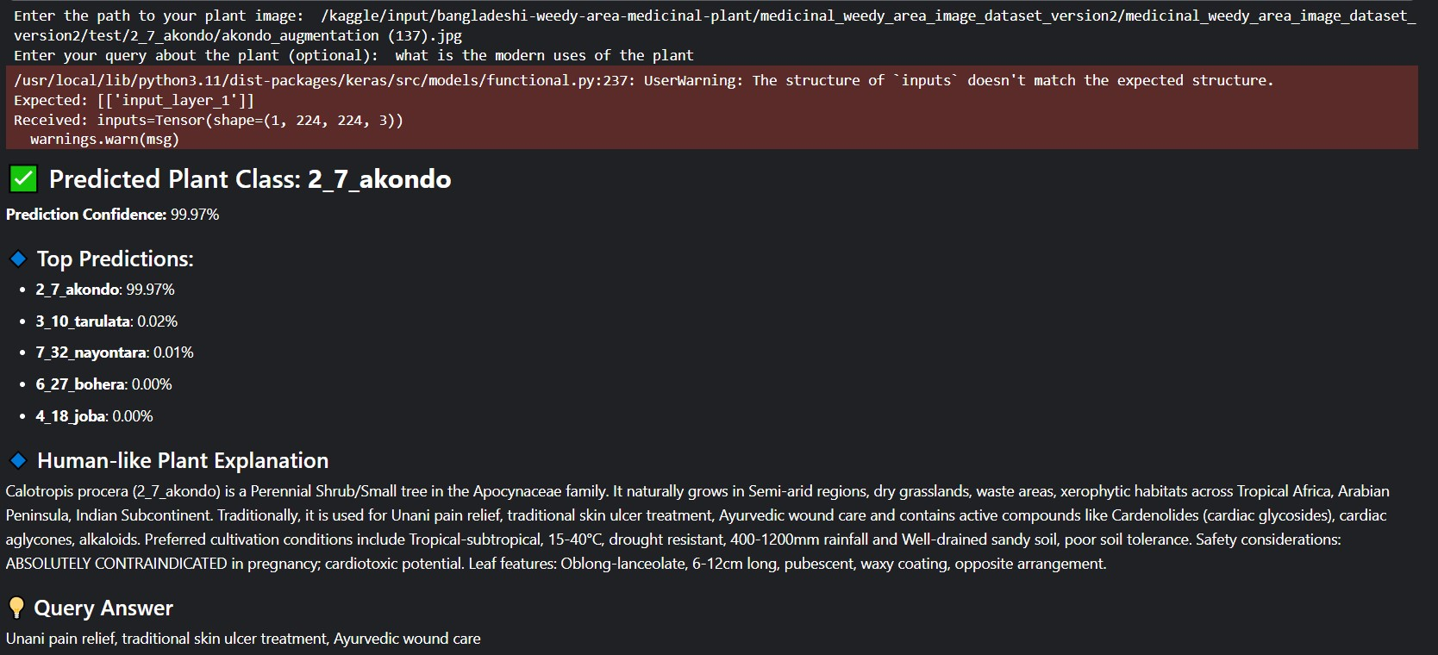
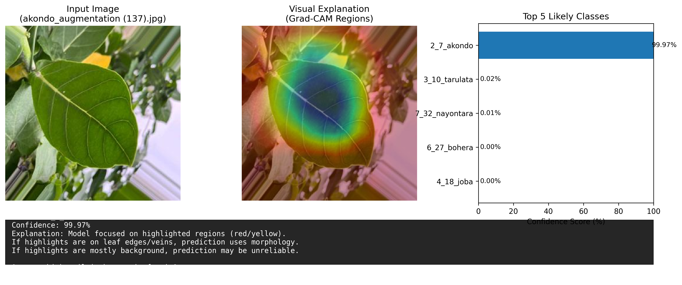
Preliminary Results / Progress
Figure 12: Explainability & Visualization (t-SNE)

Slide 20
Preliminary Results / Progress
Figure 13:Manually Test

Slide 21
Project / Thesis Timeline
 | Still Remaining
 | Running
 | Already done
Topic | Semester Weeks
 | 1 | 2 | 3 | 4 | 5 | 6 | 7 | 8 | 9 | 10 | 11 | 12 | 13 | 14 | 15 | 16 | 17 | 18 | 20 | 21 | 22 | 23 | 24 | 25 | 26 | 27 | 28
Research Topic Selection
Background & Related Works Study
Objective Finalization
Methodology Determination
Dataset Gathering
Model Implementation
Model Testing & Tuning
Report / Book Writing
Figure 11: Gantt chart for project / thesis timeline

Slide 22
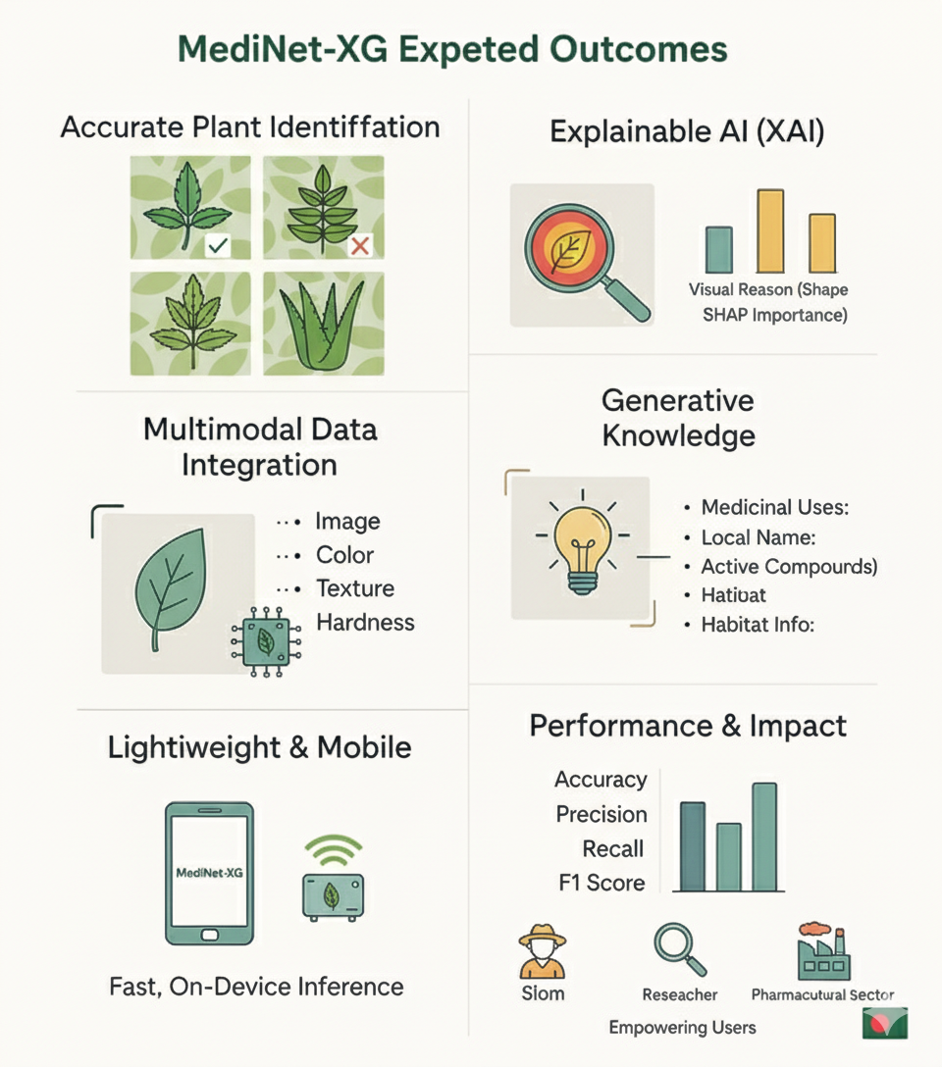
Final Outcomes
Accurate Classification: Classifying medicinal leaf into 34 categories.
Real-Time Explanation System: Explain why the class was chosen.
Multimodal Data Integration: Combining image data with user text data as query by MediNet-XG model
Generate the specific info: Knowledge based query answer.
Localized Dataset Creation with validation: Developing a unique dataset tailored to Bangladesh’s Medicinal Plant leaf of weed infested area. Validated by Botany experts
Improved Agricultural Decision-Making: Enhancing real-time decision-making for stakeholders in agriculture.
High Model Performance: Achieving optimal accuracy, precision, recall, and F1 scores for reliable outcomes.
Figure 14: Expected Outcomes

Slide 23
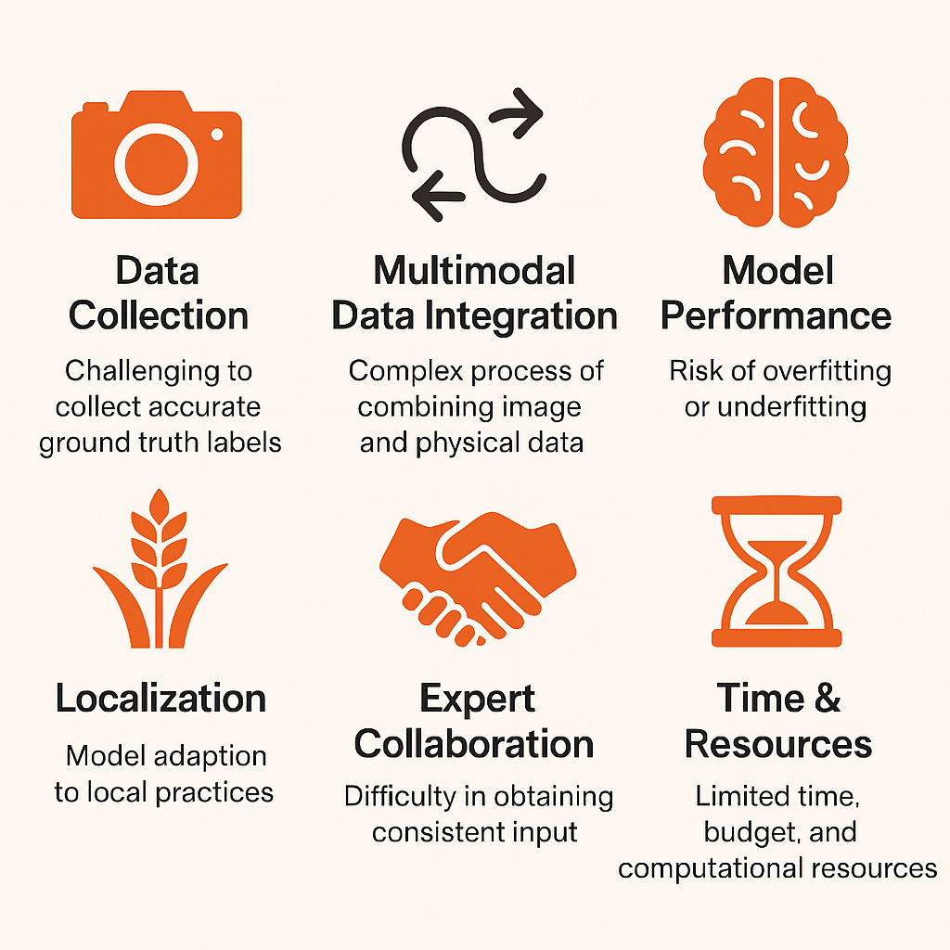
Challenges
Data Collection: Challenging to collect accurate ground truth labels and limited access in high-quality data, Imbalance data leading biased models
Multimodal Data integration: complex process of combining image and features extracted effectively
Model Performance & Generalization: Risk of overfitting or underfitting, high computational costs
Localization & Contextual Relevance: Model adaption to local farming practices, lack of domain-specific research
Collaboration and Validation: Difficult to collaborate with agri-experts
Time and Resource Constraints: Limited time frame and budget to complete such kind of complex tasks
Figure 14: Faced challenges

Slide 24
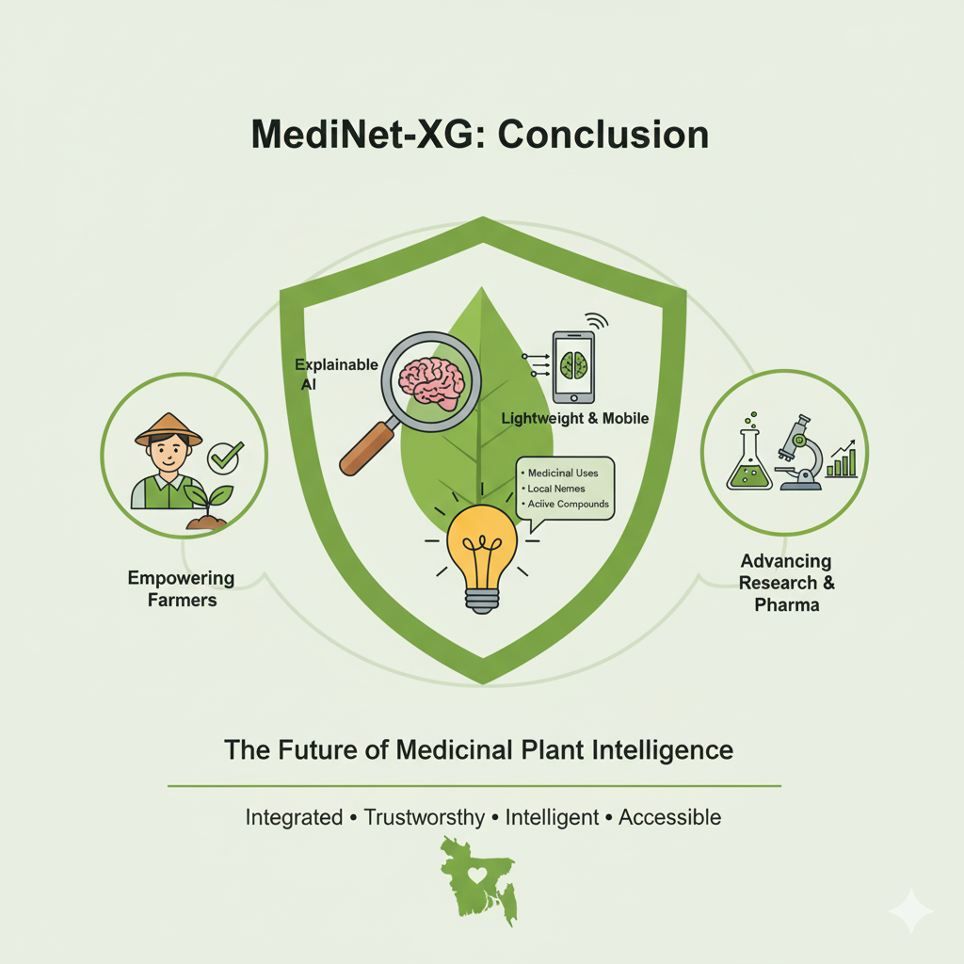
Conclusion
Medicinal plant identification in Bangladesh faces major challenges due to visual similarities, weed interference, and limited expert availability.
A lightweight explainable and feature-conditioned generative AI framework can provide an integrated solution for plant recognition, interpretation, and knowledge generation.
MediNet-XG automates classification, reveals model reasoning through explainable AI, and generates meaningful plant-specific insights.
It will support researchers, herbal practitioners, and farmers in preserving indigenous knowledge, promoting digital biodiversity monitoring, and advancing sustainable healthcare innovation in Bangladesh.
Figure 16: Conclude Overview

Slide 25
References
[1] T. B. Beressa et al. "Ethnobotanical study of traditional medicinal plants used to treat human ailments in West Shewa community, Oromia, Ethiopia." Frontiers in Pharmacology, 15 (2024). https://doi.org/10.3389/fphar.2024.1369480..
[2] Z. C. Maiyo et al. "Ethnobotanical study of medicinal plants used by the people of Mosop, Nandi County in Kenya." Frontiers in Pharmacology, 14 (2024). https://doi.org/10.3389/fphar.2023.1328903.
[3] Jamilu E. Ssenku et al. "Medicinal plant use, conservation, and the associated traditional knowledge in rural communities in Eastern Uganda." Tropical Medicine and Health, 50 (2022). https://doi.org/10.1186/s41182-022-00428-1..
[4] Abusiddique, “Bangladesh ‘Village of Herbs’ profits from planting rather than cutting trees,” Mongabay Environmental News, Jan. 22, 2024. https://news.mongabay.com/2023/07/bangladesh-village-of-herbs- profits-from-planting-rather-than-cutting-trees/
[5] “CNN-based Leaf image classification for Bangladeshi medicinal plant recognition,” IEEE Conference Publication | IEEE Xplore. https://ieeexplore.ieee.org/document/9350900

Slide 26
References
[6] A. H. Uddin, Y.-L. Chen, B. Borkatullah, M. S. Khatun, J. Ferdous, P. Mahmud, J. Yang, C. S. Ku, and L. Y. Por, “Deep-learning-based classification of bangladeshi medicinal plants using neural ensemble models,” Mathematics, vol. 11, no. 16, p. 3504, 2023.
[7] A. K. Mulugeta, D. Sharma, and A. H. Mesfin, “Deep learning for medicinal plant species classification and recognition: a systematic review,” Frontiers in Plant Science, vol. 14, 2024.
[8] M. S. I. Musyaffa, N. Yudistira, M. A. Rahman, A. H. Basori, A. B. F. Mansur, and J. Batoro, “Indoherb: Indonesia medicinal plants recognition using transfer learning and deep learning,” Heliyon, vol. 10, no. 23, 2024
[9] S. Mostafa, D. Mondal, K. Panjvani, L. Kochian, and I. Stavness, “Explainable deep learning in plant phenotyping,” Frontiers in Artificial Intelligence, vol. 6, p. 1203546, 2023.
[10] M. Guzel, B. Turan, I. Kadioglu, A. Basturk, B. Sin, and A. Sadeghpour, “Deep learning for image-based detection of weeds from emergence to maturity in wheat fields,” Smart Agricultural Technology, vol. 9, p. 100552, 2024.
[11] F. H. Bhoyan, M. H. K. Mehedi, M. Ohona, S. Rashid, and M. Mridha, “An efficient dual-attention guided deep learning model with interpretability for identifying medicinal plants,” Current Plant Biology, p. 100533, 2025.

Slide 27
References
[12] S. Kalime, P. Sujatha, D. B. Vunnava, S. Sushma, T. K. Sajja et al., “A novel multistage approach for medicinal plant classification with deep learning techniques,” International Research Journal of Multidisciplinary Technovation, vol. 7, no. 4, pp. 99–114, 2025.
[13] H. Zhao and Y. Wang, “Deep learning–based approaches for weed detection in crops,” Frontiers in Plant Science, vol. 16, p. 1746406, 2025.
[14] S. Islam, M. R. Ahmed, S. Islam, M. M. A. Rishad, S. Ahmed, T. R. Utshow, and M. I. Siam, “Bdmedileaves: A leaf images dataset for bangladeshi medicinal plants identification,” Data in Brief, vol. 50, p. 109488, 2023
[15] https://www.kaggle.com/datasets/mdnuraalambaust/bangladeshi-weedy-area-medicinal-plant
[16] Medicinal Plant Database of Bangladesh, “Medicinal plant database of bangladesh,” 2024, accessed: January 15, 2026. [Online]. Available: http://www.mpedb.com.bd/
[17] Bangladesh National Herbarium, “Official website of bangladesh national herbarium (bnh),” 2024, accessed: January 15, 2026. [Online]. Available: http://www.bnh.gov.bd/

Slide 28
References
[18] Bangladesh Association of Plant Taxonomists, “Bangladesh journal of plant taxonomy,” Bangladesh Journal of Plant Taxonomy, online ISSN: 2224-7297. [Online]. Available: https://www.banglajol.info/index.php/BJPT
[19] POWO, “Plants of the world online,” 2024, accessed: January 15, 2026. [Online]. Available: http://www.plantsoftheworldonline.org/

